Slide 1
ENABLING YOUR PRODUCTS FOR OPEN METADATA
Mandy Chessell
Distinguished engineer and master inventor at IBM
April 26, 2018
Notes:
]

Slide 2

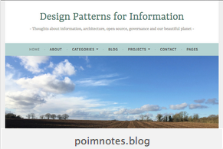


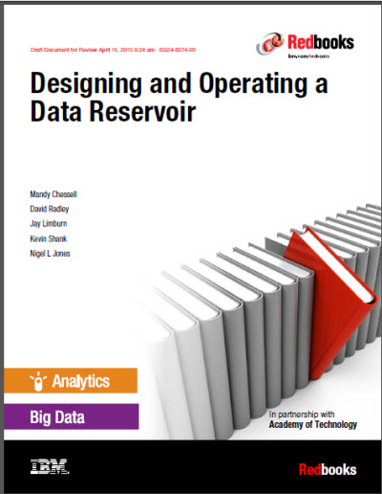
Introduction and background
Mandy Chessell CBE FREng
Distinguished Engineer, Master Inventor
Focused on Analytics, Open Metadata and Governance
30 years at IBM working on exchange and integration of data between business systems.

Slide 3
Agenda
Why open metadata?
What type of technology can use open metadata.
Integration patterns
Reference implementation modules
Integrating metadata repositories
Open metadata repository cohorts
Using the adapter pattern
Becoming a native
Integrating tools and engines
Summary

Slide 4
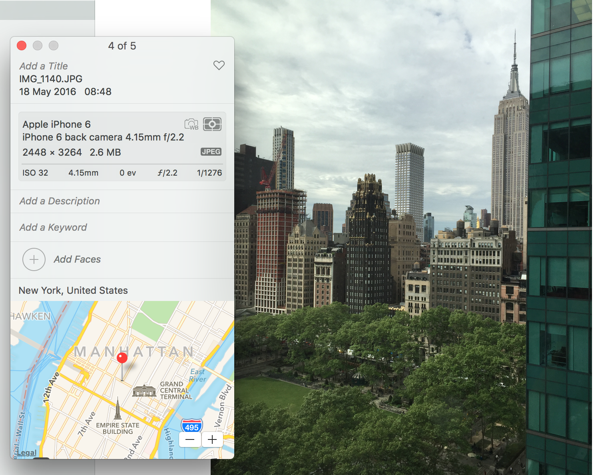
Data standards at work
4

Slide 5
Why do we need metadata?
Metadata enables data to be used outside of the application that created it.
Analytics and decision making
New business applications
Reporting and compliance
Metadata describes the format and content of data allowing people to judge which data set to use for a new project
Structure
Meaning
Origin
Valid values and quality
Usage and ownership
Regulations and classifications that apply
<more>

Slide 6
Today’s reality

Slide 7
A new manifesto for metadata and governance
Metadata management must be automated
Metadata management must become ubiquitous
Metadata must become open and remotely accessible
Metadata should be used to drive the governance of data
The discovery, maintenance and use of metadata has to be an integral part of all tools that access, change and move information.
7
Notes:
The maintenance of metadata must be automated to scale to the sheer volumes and variety of data involved in modern business.
Metadata management must become ubiquitous in cloud platforms and large data platforms, such as Apache Hadoop so that the processing engines on these platforms can rely on its availability and build capability around it.
Metadata access must become open and remotely accessible so that tools from different vendors can work with metadata located on different platforms. This implies unique identifiers for metadata elements, some level of standardization in the types and formats for metadata and standard interfaces for manipulating metadata.
Metadata should be used to drive the governance of data and create a business friendly logical interface to the data landscape.
Wherever possible, discovery and maintenance of metadata has to an integral part of all tools that access, change and move information.

Slide 8
What needs to change?
Open and
Unified Metadata

Slide 9
Open Metadata and Governance
Open APIs for tools and engines
Apache Atlas
Metadata
Repository
Metadata
Repository
Data Tools
Security Tools
Open Metadata Highway
Open metadata exchange and federated queries

Slide 10


Scared to share
Very Sensitive Data
Very Sensitive Data
Faith Broker
Human Resources
00 3809890 6 7 Lemmie Stage 818928 3082 4 New York 4 27 DataStage Expert 1 45324 300 27 Code St Harlem NY 1 3
00 3809890 3 7 Callie Quartile 328080 7432 5 New York 4 27 Data Scientist 1 56944 045 27 Code St Harlem NY 1 3
00 3809890 1 7 Tanya Tidie 209482 4051 2 New York 4 27 Data Steward 1 43800 215 27 Code St Harlem NY 1 3
00 3809890 6 7 Lemmie Stage 818928 3082 4 New York 4 27 DataStage Expert 1 ##### ### 27 Code St Harlem NY 1 3
00 3809890 3 7 Callie Quartile 328080 7432 5 New York 4 27 Data Scientist 1 ##### ### 27 Code St Harlem NY 1 3
00 3809890 1 7 Tanya Tidie 209482 4051 2 New York 4 27 Data Steward 1 ##### ### 27 Code St Harlem NY 1 3
Callie Quartile
Data Scientist

Slide 11
Using glossary function for semantic processing
Business
metadata
IS-A
Employee
Sensitive
HAS-A
Work Location
HAS-A
HAS-A
Hourly Pay Rate
Manager
Compensation Plan
HAS-A
IS-A
HAS-A
Job Title
IS-A
HAS-A
Employee Id
Annual Salary
Employee Name
Structural
metadata for
a data store
EmpName
EmpNo
JobCode
Salary
Employee Record
Data
00 3809890 6 7 Lemmie Stage 818928 3082 4 New York 4 27 DataStage Expert 1 45324 300 27 Code St Harlem NY 1 3
Notes:
Business metadata describes the data that the business needs, what it means and how it should be classified and protected.
Structural metadata describes how the data is actually stored and labelled in the data store.
The linkage between the business and technical metadata allows our technology to switch between these two perspectives. For example,
A request for data expressed in business terminology can be translated into a query for data from a data store.
An integration engine copying data into a sand box can discover which are the fields that the business classifies as sensitive and then mask these values dynamically.

Slide 12
Automating governance with open metadata
Define Policies
Control Data Use
IBM
Information
Governance
Catalog
Apache Atlas
Gaian
Data Virtualization
Apache Ranger
Manage Data Access
Open Metadata Highway

Slide 13

Different personas need different services
Callie Quartile
Data Scientist
Find data
Understand data
Manage analytics models
Build data strategy
Define governance program
Monitor progress
Jules Keeper
Chief Data Officer

Slide 14

Different personas need different services
Faith Broker
HR and Privacy Officer
Locate personal data
Ensure protection of personal data
Understand employee needs
Maintain “safe” IT Infrastructure
Build and deploy “good” APIs and services
Locate and resolve issues fast
Gary Geeke
IT

Slide 15


Different personas need different services
Tanya Tidie
Clinical Trials Administrator
Maintain accurate patient records
Catalog clinical trials data
Demonstrate good data management practices
Understand risks to organization
Set up protection
Monitor for suspicious activity
Ivor Padlock
Chief Security Officer

Slide 16
Many points of integration
Governance Platform
Analytics Platform
Reporting Platform
Open Metadata and Governance
Data Platform
ETL Platform
Virtualization Platform
Notes:
Engines
Data Integration and Movement
Data Virtualization
Data Security
DevOps Pipeline
Test Data Managers
Archive/retention managers
Tools
Governance tools
Data Science tool
Developer tools
Data Quality tools
Data Curation tools
BI Tools
Data Architecture tools
Metadata repositories
Data Set Providers (eg Open Data sites)
Cloud platforms
Governed data platforms
Metadata driven tools

Slide 17
Specialized services around shared collection of metadata
Asset Owner
Subject Area
Information View
Asset Catalog
Community Profile
Stewardship Action
Shared Common
Metadata stored in
multiple metadata repositories
Project Management
Governance Program
Data Science
Information Process
Developer
Information Protection
Information Landscape
Governance Engine
DevOps
Information Infrastructure
Data Platform
Connected Asset
Asset Consumer
Discovery

Slide 18
Three concepts to understand
Open metadata types
OMRS - Repository services and open metadata repository cohorts
OMAS - Access services for data tools and engines

Slide 19
Open Metadata Types
Open metadata and governance

Slide 20
Specialized services around shared collection of metadata
Asset Owner
Subject Area
Information View
Asset Catalog
Community Profile
Stewardship Action
Shared Common
Metadata
Project Management
Governance Program
Data Science
Information Process
Developer
Information Protection
Information Landscape
Governance Engine
DevOps
Information Infrastructure
Data Platform
Connected Asset
Asset Consumer
Discovery

Slide 21
Scope of shared metadata
Governance
Glossary
Collaboration
Models and
Reference Data
Lineage
Metadata
Discovery
Data Assets
Base Types, Systems
and Infrastructure

Slide 22
Open metadata type model summary
O-DEF
Strategy
4
Subject Area Definition
1
Teaming Metadata
(people profiles, communities, projects,
notebooks, …)
Policy Metadata (Principles, Regulations, Standards, Approaches, Rule Specifications, Roles and Metrics)
Business Objects and Relationships, Taxonomies and Ontologies
Augmentation
3
Organization
Feedback Metadata
(tags, comments, ratings, …)
Rollout
Classification
Business Attributes
Campaigns and Projects
Classification Schemes
Implementation
Mapping
Governance Actions and Processes
Rights
Management
Models and Schemas
2
Asset Collections
(Sets, Typed Sets, Type Organized Sets)
Reference Data
5
Instrument
7
Information Process
Instrumentation (design lineage)
Association
Information Views
Augmentation
Discovery
Metadata (profile data, technical classification, data classification,
data quality assessment, …)
Physical Asset Descriptions
(Data stores, APIs,
models and components)
0
Basic Types, Infrastructure and Systems
Access
6
Connectors

Slide 23
Metadata Type System

Slide 24
Open metadata meta-types, types and instances

Slide 25
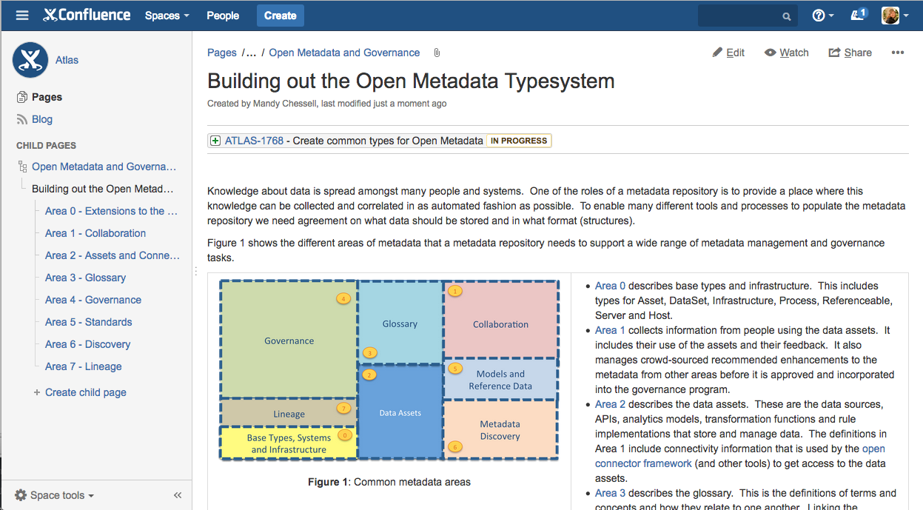
More detail here … https://cwiki.apache.org/confluence/display/ATLAS/Building+out+the+Open+Metadata+Typesystem

Slide 26
Repository Services
Open metadata and governance

Slide 27
Inside the server

Slide 28
Inside the server

Slide 29
Integration patterns
https://cwiki.apache.org/confluence/display/ATLAS/Integrating+into+the+Open+Metadata+and+Governance+Ecosystem

Slide 30
Caller Pattern
A metadata tool or engine can access the consumer-specific APIs to work with metadata.
The Access Layer handles the calls to metadata repositories connected to the metadata highway

Slide 31
Adapter Pattern
Simple components plug into a repository proxy to connect in an existing metadata repository.

Slide 32
Native Pattern
Native implementation of the open metadata governance APIs
Apache Atlas is a native implementation of the open metadata and governance APIs.

Slide 33
Heterogeneous integration

Slide 34
Simple cohort
Data Lake
Cohort A
Chief Data Office
Systems of Record

Slide 35
Multiple cohorts
Marketing
Data Lake
Data Lake
Cohort A
Cohort B
Chief Data Office
Systems of Record
Systems of Record
Mobile
Apps

Slide 36
Types of OMRS Events

Slide 37
First server

Slide 38
Establishing contact

Slide 39
Federated queries

Slide 40
Caching metadata for availability and performance

Slide 41
Reference implementation in Apache Atlas
Reference implementation
Java Library
Atlas Server
OMAG Server
Admin API
Admin API
Admin API
OMRS API
OMRS API
OMRS API
OMAS APIs
OMAS APIs
OMAS APIs
JanusGraph
Repository

Slide 42
Repository Connectors

Slide 43
Event Mappers

Slide 44
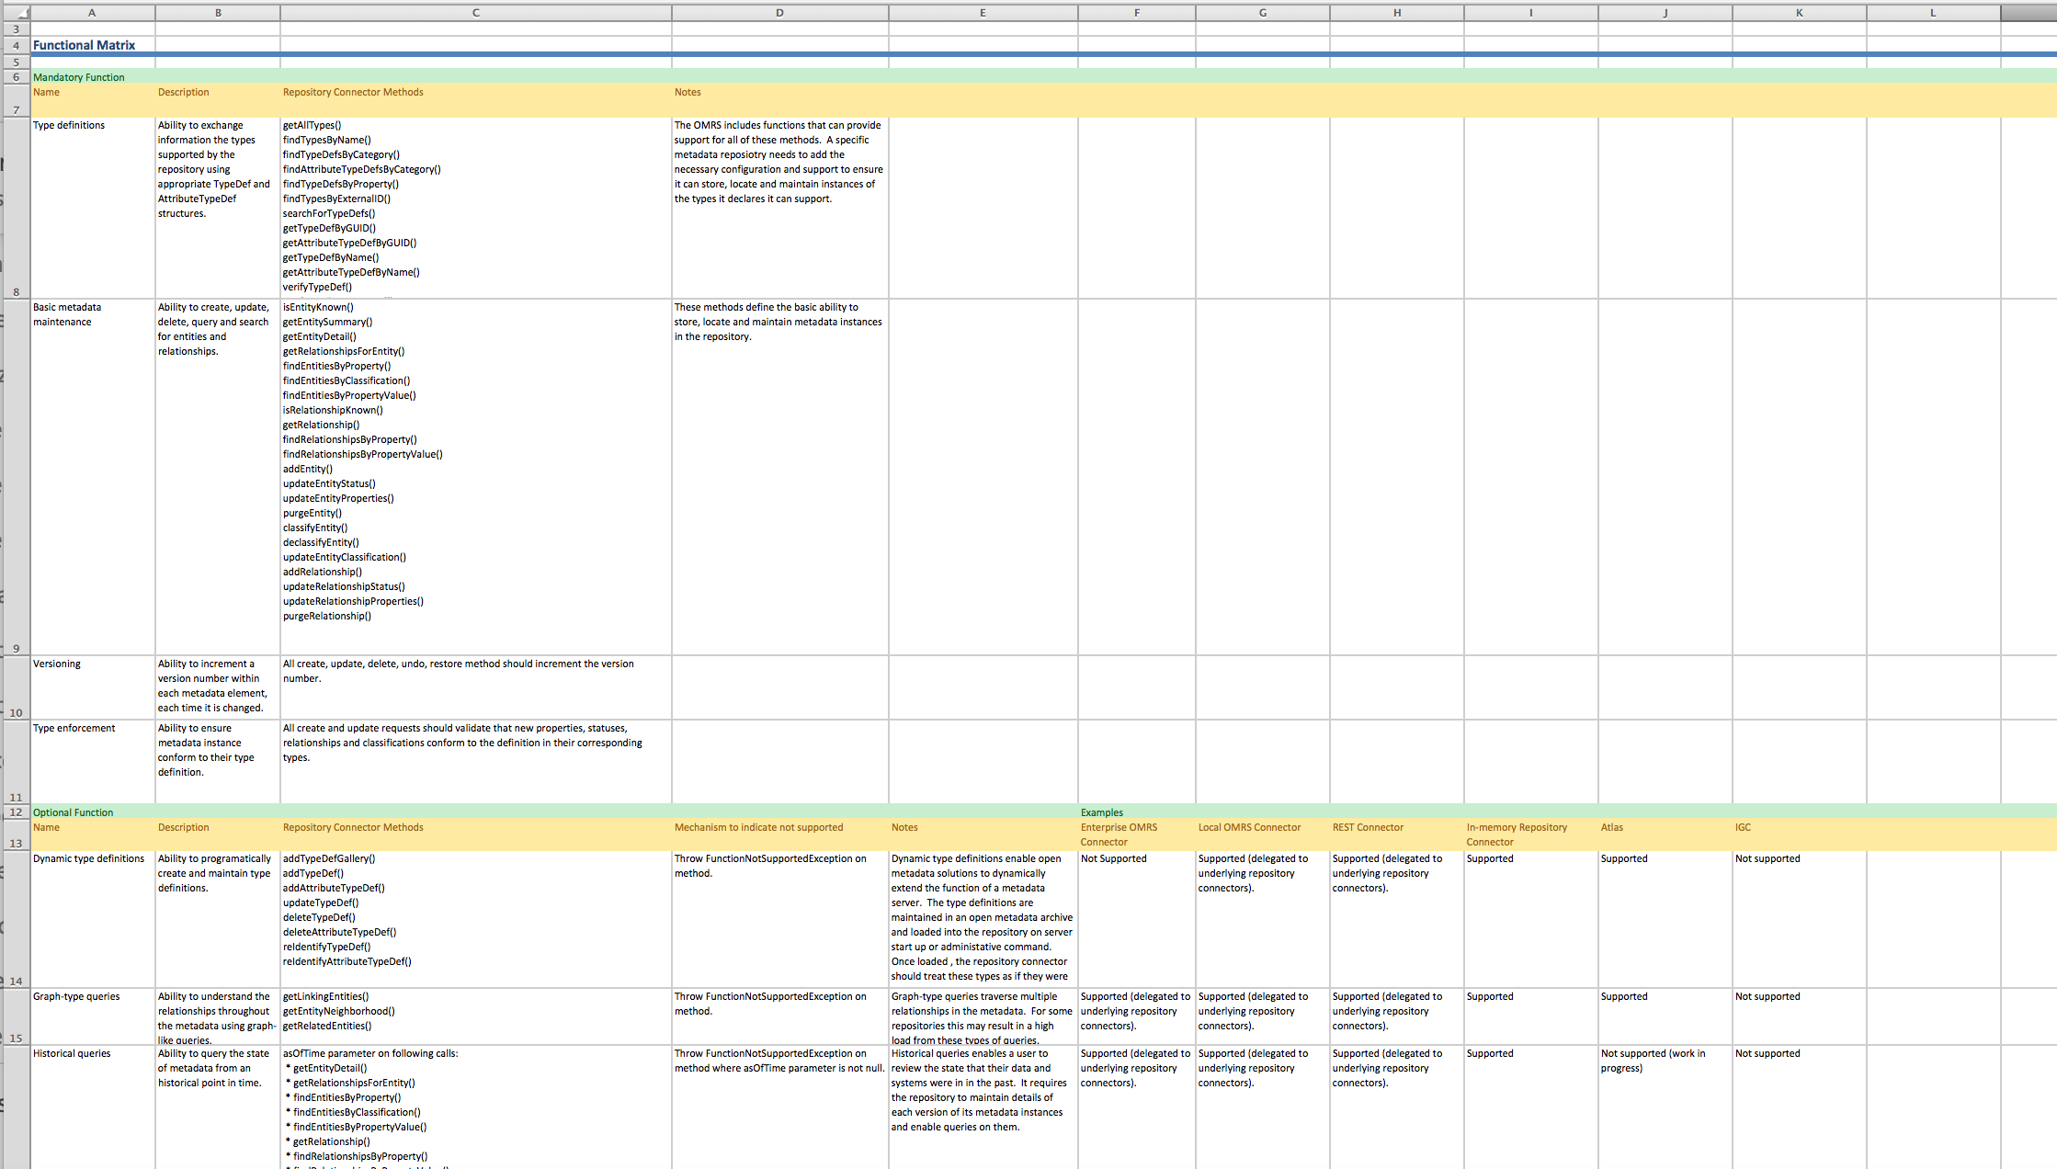
Repository Compliance Workbook
Mandatory capability
Optional capability
Action to indicate “not supported
Examples of connector support
https://github.com/odpi/data-governance/tree/master/compliance/repository-compliance

Slide 45
Integrating through the Access Services
Open Metadata and Governance

Slide 46
Specialized services around shared collection of metadata
Asset Owner
Subject Area
Information View
Asset Catalog
Community Profile
Stewardship Action
Shared Common
Metadata
Project Management
Governance Program
Data Science
Information Process
Developer
Information Protection
Information Landscape
Governance Engine
DevOps
Information Infrastructure
Data Platform
Connected Asset
Asset Consumer
Discovery

Slide 47
OMAS service instance
Both call API and notifications

Slide 48
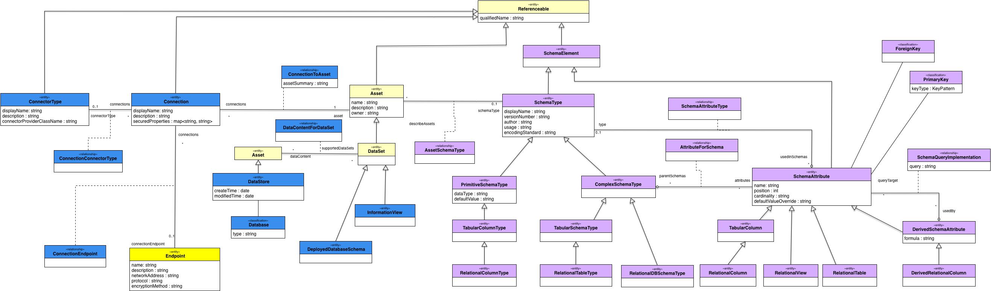
Example of the metadata for a relational schema

Slide 49
Asset information from Connected Asset OMAS

Slide 50
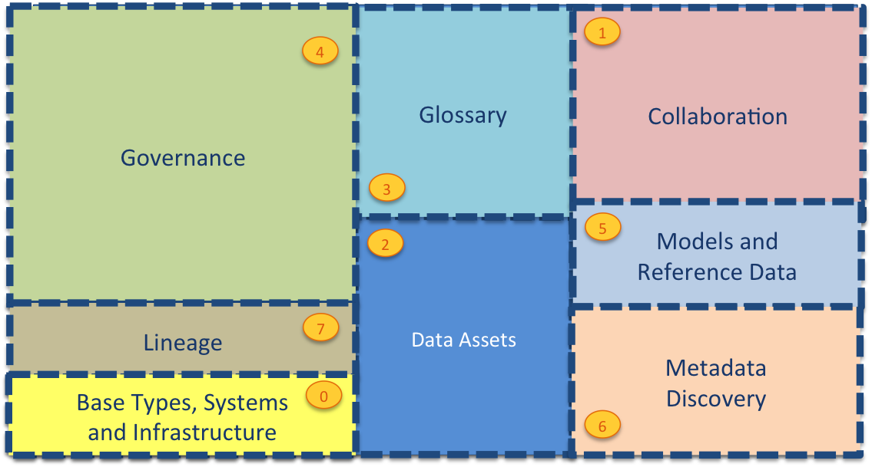
Open Metadata Access Services – current status
Asset Owner
Subject Area
Information View
Asset Catalog
Community Profile
Stewardship
Project Management
Governance Program
Data Science
Information Process
Developer
Information Protection
Information Landscape
Governance Engine
DevOps
Information Infrastructure
Data Platform
Connected Asset
Asset Consumer
Discovery

Slide 51
Summary
Open Metadata and Governance

Slide 52
Updates to Apache Atlas
Automation
Capture of metadata from data platforms, data movement engines and data protection engines.
Exception management and stewardship
Business Value
Specialized services for key data roles such as CDO, Data Scientist, Developer, DevOps Operator, Asset Owner, Applications
Connectivity
Metadata Highway offering open metadata exchange, linking and federation between heterogeneous metadata repositories.

Slide 53
More information
Apache Atlas project
https://cwiki.apache.org/confluence/display/ATLAS/Open+Metadata+and+Governance
ODPI Data Governance PMC resources
https://github.com/odpi/data-governance
https://www.odpi.org/projects/data-governance-pmc
53

Slide 54
z
z
z
z
z
z
z
Questions?

Slide 55

Join us for the next ODPI webinar!
Thursday, July 12
9 am PDT/12 pm EDT
Managing Privacy
Stay tuned for more details…

